Slide 1
Uber Data Analytics
Data Engineering & Analytics Project – Part 1 :- Performing Dimension modeling

Slide 2
Uber Data Engineering and Analytics Project: Overview
I applied Pandas to clean and manipulate data from a flat file table
I designed a star schema with fact and dimension tables and loaded data on Google Cloud Run VM instances
I used Mage AI, an open-source data pipeline tool, to perform ETL (extract, transform, load) operations on the data
I exported the transformed data to Google BigQuery and ran queries to find insights
I created an interactive dashboard with Google Data Studio to visualize the data and insights

Slide 3
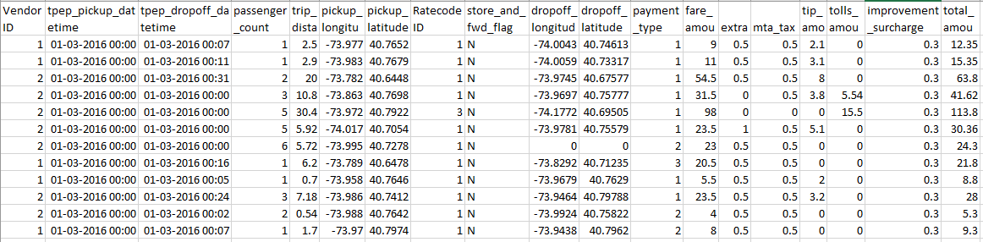
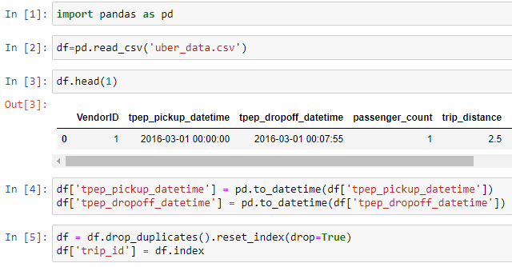
Dataset
Performed Data Cleaning :-
Changed datetime format from object to datetime.
Removed Duplicates from the dataset
Assigned Index value to “trip_id” column

Slide 4
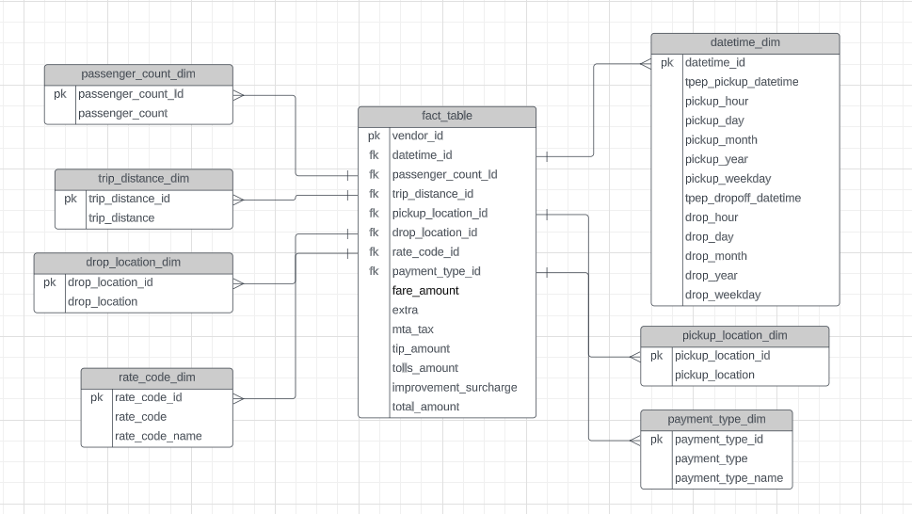
Created Fact & Dimension table on Lucidchart

Slide 5
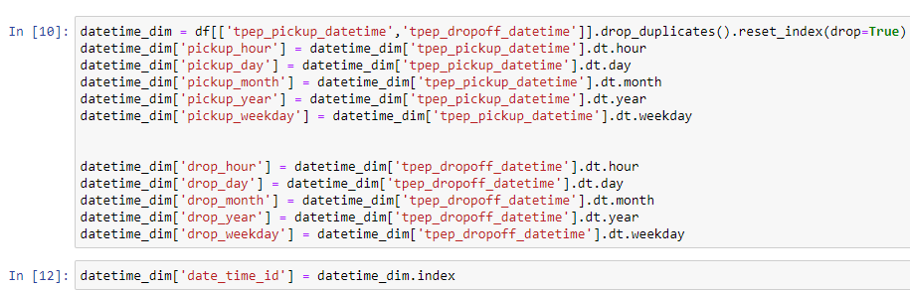
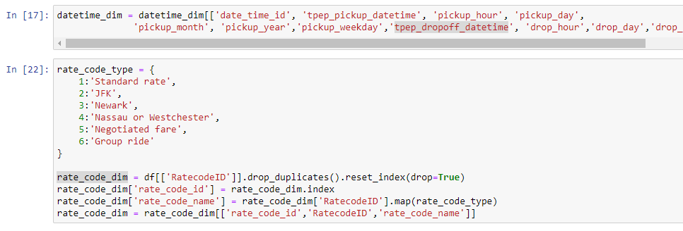
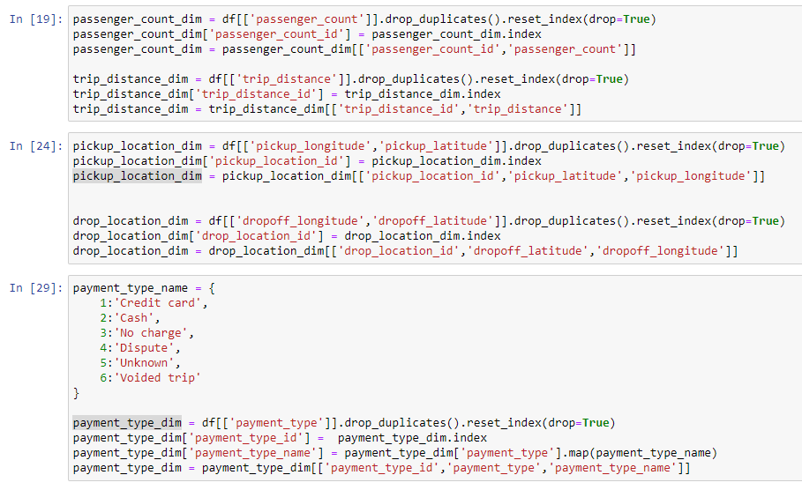
I used dt functions to extract hour, day, month, year and weekday from the datetime column and created a dimension table.
A new column rate_code_name was added by mapping ratecodeID with a new dictionary rate_code_type.
Similar process was followed for payment_type_dim to create a new column payment_type_name

Slide 6
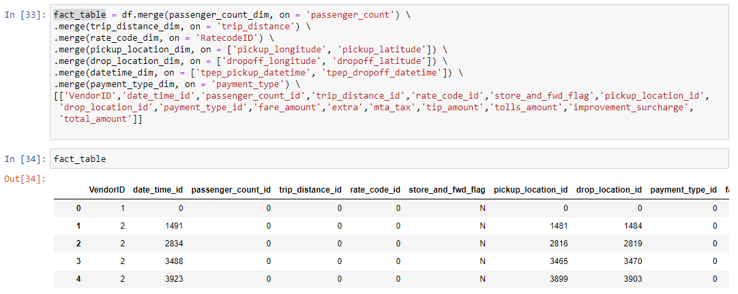
The fact table was created in order by merging all 7 dimension tables that I created with the remaining columns

